Slide 1

The Healing Paw: A Veterinary Clinic Website Analysis & Design
Name: Panagiotis Iatridis
Student Number: S22010935
Submission Date: 18/03/2023

Slide 2
Roadmap of my Analysis & Design
Overview
Goals & Objectives
Content Structure
Analysis of the Competition
References

Slide 3
Overview
Background Information - Why is this Website needed? (1)
1. 24/7 Accessibility
The website will allow pet owners to access information about the Clinic and its services at any time, from anywhere [1] [2].
2. Convenience
It can offer a convenient and streamlined booking system for appointments, that can save time and effort for both pet owners and the clinic staff [1].
3. Educational Resources
It can also provide educational resources on pet care topics, such as health issues, to help pet owners decide responsibly about their pet’s health and well-being [1] [2].

Slide 4
Background Information - Why is this Website needed? (2)
4. Communication
The website can act as a two-way communication between a pet owner and the clinic staff. Thus, it can help build relationships and loyalty with clients, and provide a way to gather feedback and improve services [1] [2].
5. Credibility
A well-designed and informative website can establish the clinic as a credible and trustworthy source of pet care. Thus, it can also attract new clients [1] [2].
6. Branding & Marketing
The website will showcase the clinic’s unique brand and values, as well as market its services to a wider audience. This can help attract new clients and increase awareness of the clinic in the community [1].

Slide 5
Background Information – What will the Website accomplish?
My website will provide pet owners in the local community or surrounding areas with a reliable and informative resource [1] [2] for high-quality veterinary care, by offering information on the clinic’s services and values, as well as educational resources [1] [2].
Additionally, it will help establish the clinic as a trusted source of pet care [1] [2], by offering online appointment scheduling and after-hours support, making it easy for pet owners to access veterinary care, even if they have busy schedules or limited availability during traditional business hours.
Ultimately, it will provide a valuable service to pet owners [1] [2] and help improve the health and well-being of the pets in the community [2].

Slide 6


Target Audience
1. Pet Owners from the local community or surrounding areas. (This may include pet owners of all ages, from young families with children and pets, to older adults who are passionate about their furry companions.)
2. Animal Welfare Associations from the local community or surrounding areas.

Slide 7

Opportunities, Problems and Issues addressed by the website
1. Lack of Information about Veterinary Care
2. Convenience & Accessibility
3. Difficulty in finding a reliable Vet Clinic

Slide 8

Goals & Objectives

Slide 9

The Goals
1. To build a website about the Healing Paw Veterinary Clinic.
2. To include information about the Clinic, its history and values, as well as the staff and the services provided [2].
3. To create a form, so that people can book appointments on a 24/7 basis [1].
4. To provide additional educational resources on common health issues, in order to help people make informed decisions about their pet’s health[2].
5. To include contact information [2] for the clinic, as well as a 24/7 support line.

Slide 10

The Objectives
1a) Research existing Veterinary Clinics’ Websites, their structure and content [2].
1b) Analyze existing designs [2].
1c) Research Accessibility options that could be integrated in the Website [1].
1d) Build the Healing Paw Website step by step, starting with the Home Page [1].
2a) Build an About Us Page with information about the Clinic, its history and values, and the staff [1] [2].
2b) Build a Services Page, that will provide info about the clinic’s services [1] [2].

Slide 11
The Objectives
3) Create a Book an Appointment Page, that will include a form for pet owners to book their appointment [1].
4) Build a Resources Page, with additional info on common health issues [1] [2].
5a) Build a Contact Page for the Healing Paw Website, that will include every contact information for the Clinic [1] [2].
5b) Check the Website’s Structure and Contents, as well as its Navigation Links [1].

Slide 12

Content Structure

Slide 13
Sitemap
Home Page
0.0
home.html
Book an Appointment
3.0
book_app.html
About Us
1.0
about.html
Services
2.0
services.html
Resources
4.0
resources.html
Contact
5.0
contact.html
Our History & Values
1.1
history.html
Our Staff
1.2
staff.html

Slide 14

Storyboards and Content

Slide 15
Home Page 0.0
Banner
Logo
24-7 Support Line
About us
Services
Book an Appointment
Resources
Contact
Image
Heading 1
Appointment Link
Our Services
Paragraph
Services Link
About Us
Paragraph
About Us Link
Hospital Location
Location
24-7 Support Line
About Us
Our History and Values
Our Team
Services
List of Services
Appointment
Resources
Contact
Logo

Slide 16
About Us 1.0
Banner
Logo
24-7 Support Line
About us
Services
Book an Appointment
Resources
Contact
Heading 1
Heading 2
Paragraphs
Our History & Values Link
Our Staff Link
Hospital Location
Location
24-7 Support Line
About Us
Our History and Values
Our Team
Services
List of Services
Appointment
Resources
Contact
Logo

Slide 17
Our History & Values 1.1
Banner
Logo
24-7 Support Line
About us
Services
Book an Appointment
Resources
Contact
Heading 1
Paragraphs
Services Link
Hospital Location
Location
24-7 Support Line
About Us
Our History and Values
Our Team
Services
List of Services
Appointment
Resources
Contact
Logo

Slide 18
Our Staff 1.2
Banner
Logo
24-7 Support Line
About us
Services
Book an Appointment
Resources
Contact
Heading 1
Paragraph
Services Link
List of Staff Members
Image
Hospital Location
Location
24-7 Support Line
About Us
Our History and Values
Our Team
Services
List of Services
Appointment
Resources
Contact
Logo

Slide 19
Services 2.0
Banner
Logo
24-7 Support Line
About us
Services
Book an Appointment
Resources
Contact
Heading 1
Paragraph
Image
Heading 2
Paragraph
Image
Heading 2
Paragraph
Image
Heading 2
Paragraph
Image
Heading 2
Paragraph
Image
Heading 2
Paragraph
Image
Heading 2
Paragraph
Image
Heading 2
Paragraph
Image
Heading 2
Paragraph
Image
Heading 2
Paragraph
Image
Heading 2
Paragraph
Hospital Location
Location
24-7 Support Line
About Us
Our History and Values
Our Team
Services
List of Services
Appointment
Resources
Contact
Logo

Slide 20
Book an Appointment 3.0
Banner
Logo
24-7 Support Line
About us
Services
Book an Appointment
Resources
Contact
Heading 1
Appointment Form
Services Link
Hospital Location
Location
24-7 Support Line
About Us
Our History and Values
Our Team
Services
List of Services
Appointment
Resources
Contact
Logo

Slide 21
Resources 4.0
Banner
Logo
24-7 Support Line
About us
Services
Book an Appointment
Resources
Contact
Heading 1
Paragraphs
Lists
Paragraph
Video
Hospital Location
Location
24-7 Support Line
About Us
Our History and Values
Our Team
Services
List of Services
Appointment
Resources
Contact
Logo

Slide 22
Contact 5.0
Banner
Logo
24-7 Support Line
About us
Services
Book an Appointment
Resources
Contact
Heading 1
Map
Heading 2
Location | 24/7 Support Line
Book an Appointment Link | Paragraph
Contact Form
Hospital Location
Location
24-7 Support Line
About Us
Our History and Values
Our Team
Services
List of Services
Appointment
Resources
Contact
Logo

Slide 23




Visual Design
Accessibility
1. Consistent Layout / Simple Navigation
1. Heading tags with semantic meaning (Screen Readers)
2. Colors: #eff0f2
#ffffff
#8a9e6f
#28493c
2. header, nav, main, footer and label tags
3. alt attributes for images
4. fieldset and legend tags and date picker for forms
3. Font: brandon-grotesque
Fallback Font: sans-serif
5. Lowest contrast ratio 2.55:1 (Colorblindness)
4. Graphics: Images, Video and Map
6. Use of video format (Youtube Video)

Slide 24

Analysis of the Competition

Slide 25
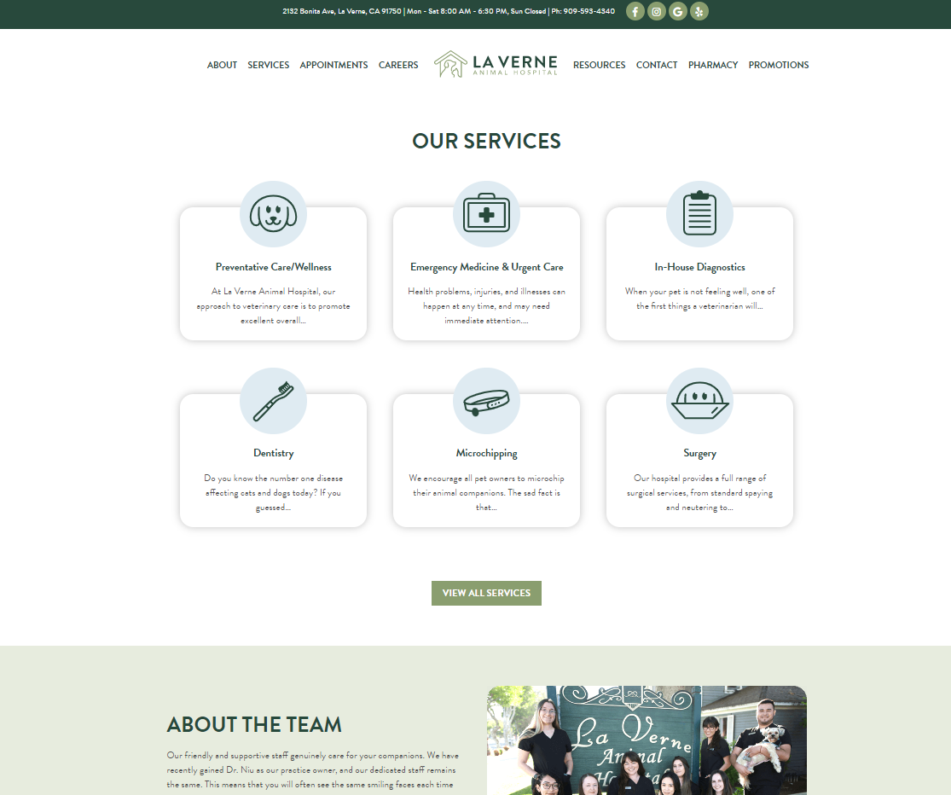
Website #1 [3]
1. Consistent Layout throughout the pages
2. Great element alignment
3. Easy Navigation
4. Simple Visual Design / Good Aspect Ratio / Use of Graphics
5. Simple and easy-to-read font

Slide 26
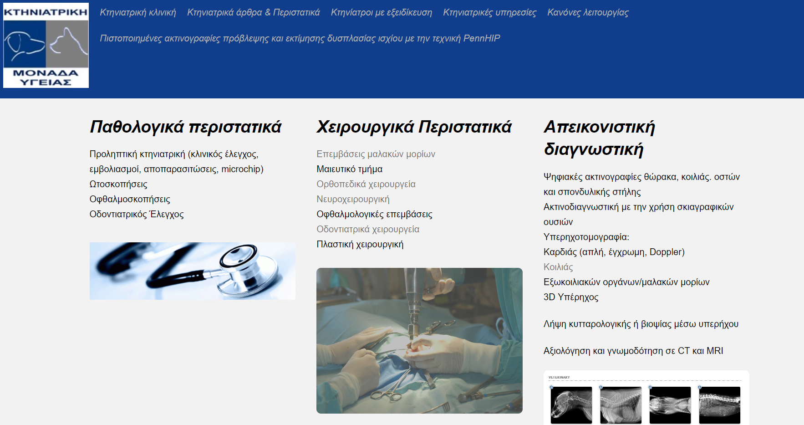
Website #2 [4]
1. Inconsistent Layout throughout the pages
2. Poorly aligned elements
3. Confusing and badly designed Navigation
4. Mediocre Visual Design / Bad Aspect Ratio at some points
5. Simple font, but extensive use of text

Slide 27
How my findings have influenced my Website?
Through my findings I decided to focus more on:
1) Building a consistent Layout for all of my pages, with emphasis on element alignment.
2) Creating a simple navigation format, for users to find information easily.
3) Impoving my design by using, visually appealing colors, fonts and making it more user-friendly.

Slide 28

References
[1] George Plumley, Website Design and Development: 100 Questions to Ask Before Building a Website, Wiley Publishing, 2010.
[2] L. C. Schaupp, Weiguo Fan and F. Belanger, “Determining Success for Different Website Goals”, Proceedings of the 39th Annual Hawaii International Conference on System Sciences (HICSS’06, Kauia, HI, USA, 2006.
[3] “La Verne Animal Hospital Website” [Online]
Available: https://laverneanimalhospital.com/
[Accessed: Mar. 18, 2023]
[4] “KMY Website” [Online]
Available: https://kmy.gr/
[Accessed: Mar. 18, 2023]

Slide 29
Thank you!

